Slide 1
Heads and Chairs Briefing Suzanne McDonald – Assistant Director School Organisation David Williams – Assistant Director School Effectiveness
General guidance for the session
Please mute your microphone unless you are addressing the group
If you have any questions, please type them in to the chat box
Please amend your name details so we know how to address you

Slide 2
Agenda
• Welcome and reflection
• Virtual housekeeping
• Go Team - updates
• School Effectiveness - updates
• Focus - SIAMS next steps
• School Organisation - updates
• Focus - Recruiting governors
• Question Time

Slide 3
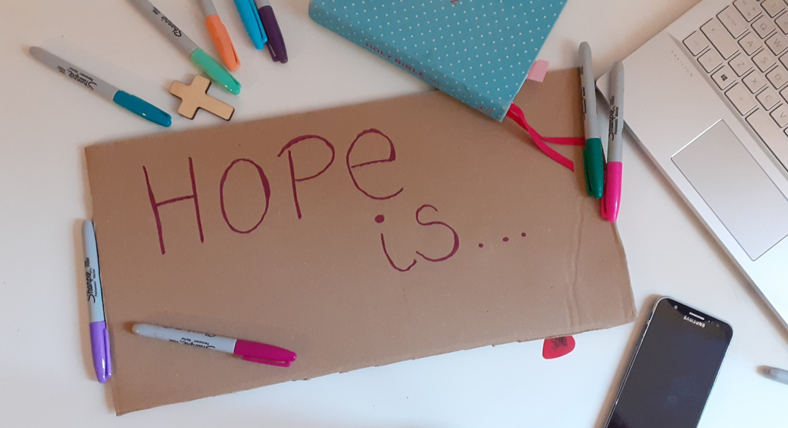
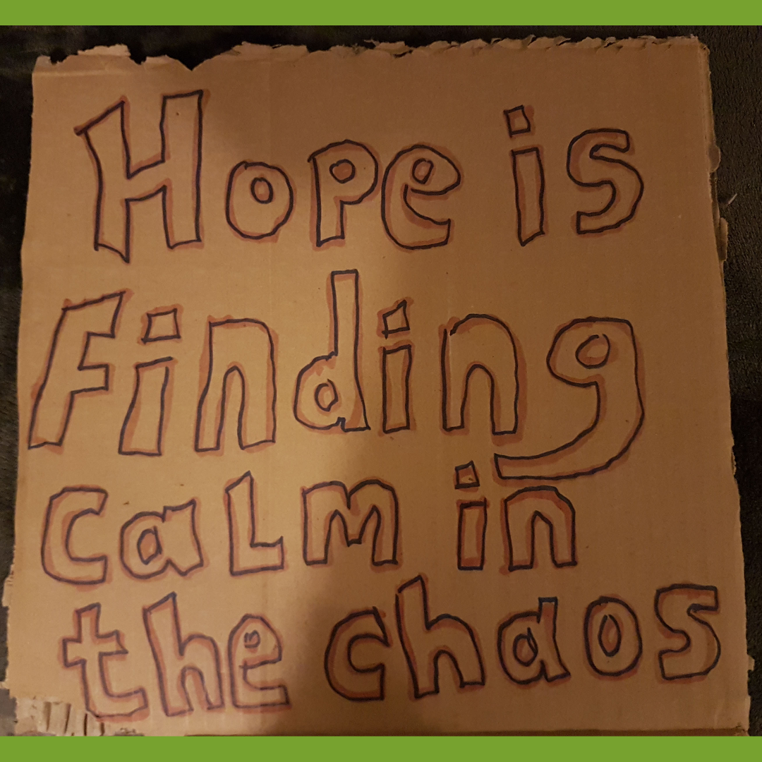
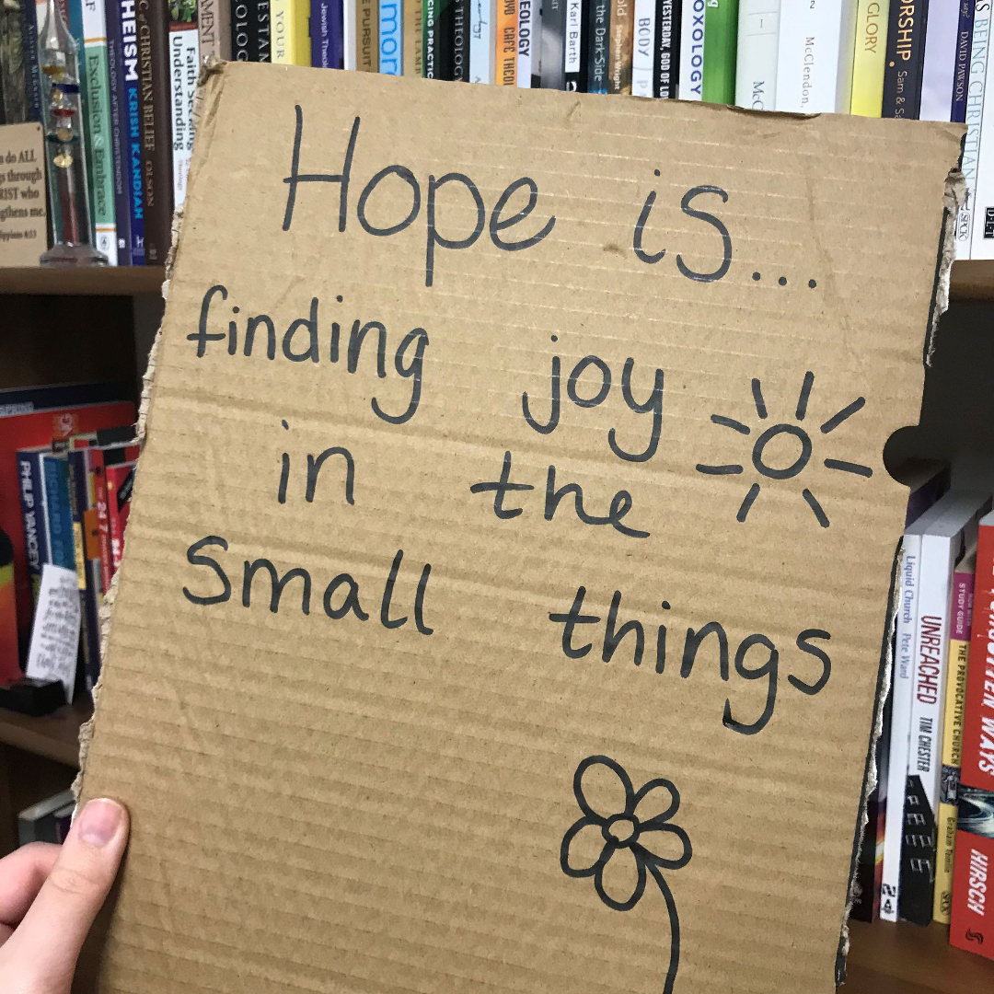
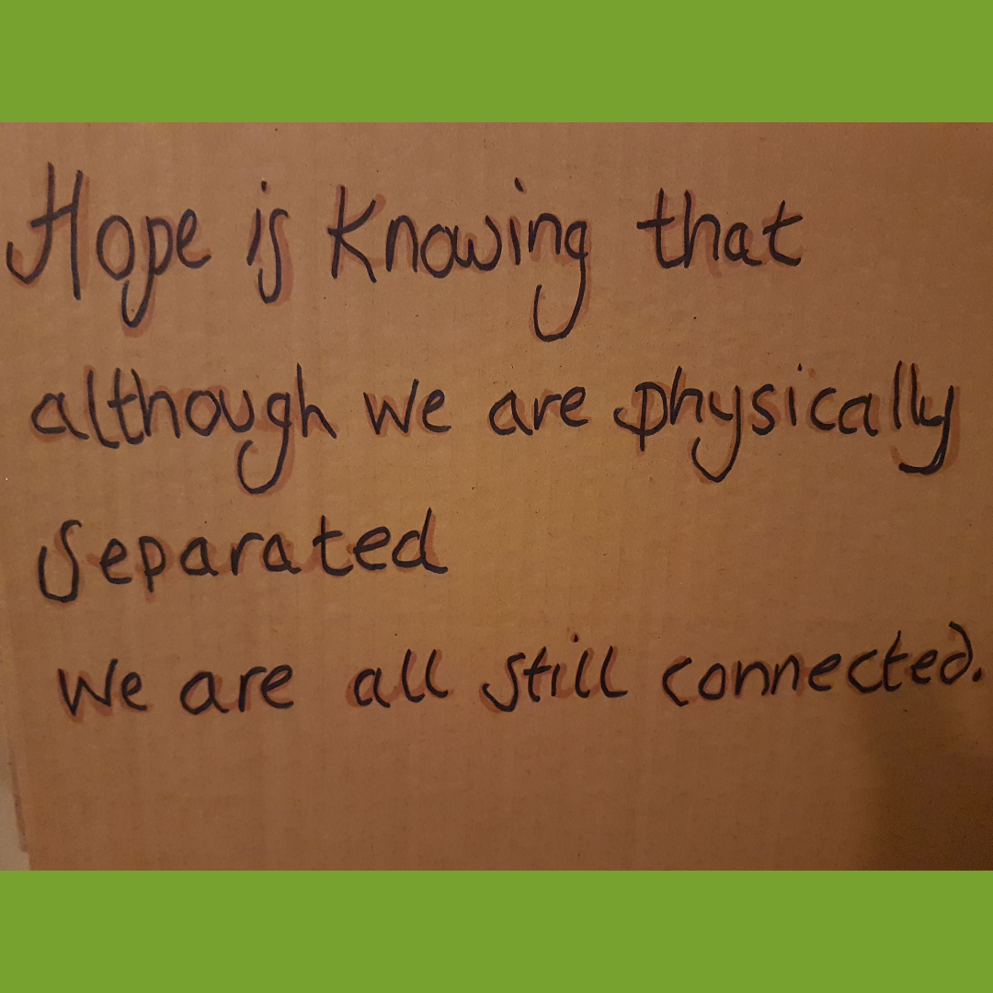
Go Team Update – Hope Is…

Slide 4
Go Team Update

Slide 5
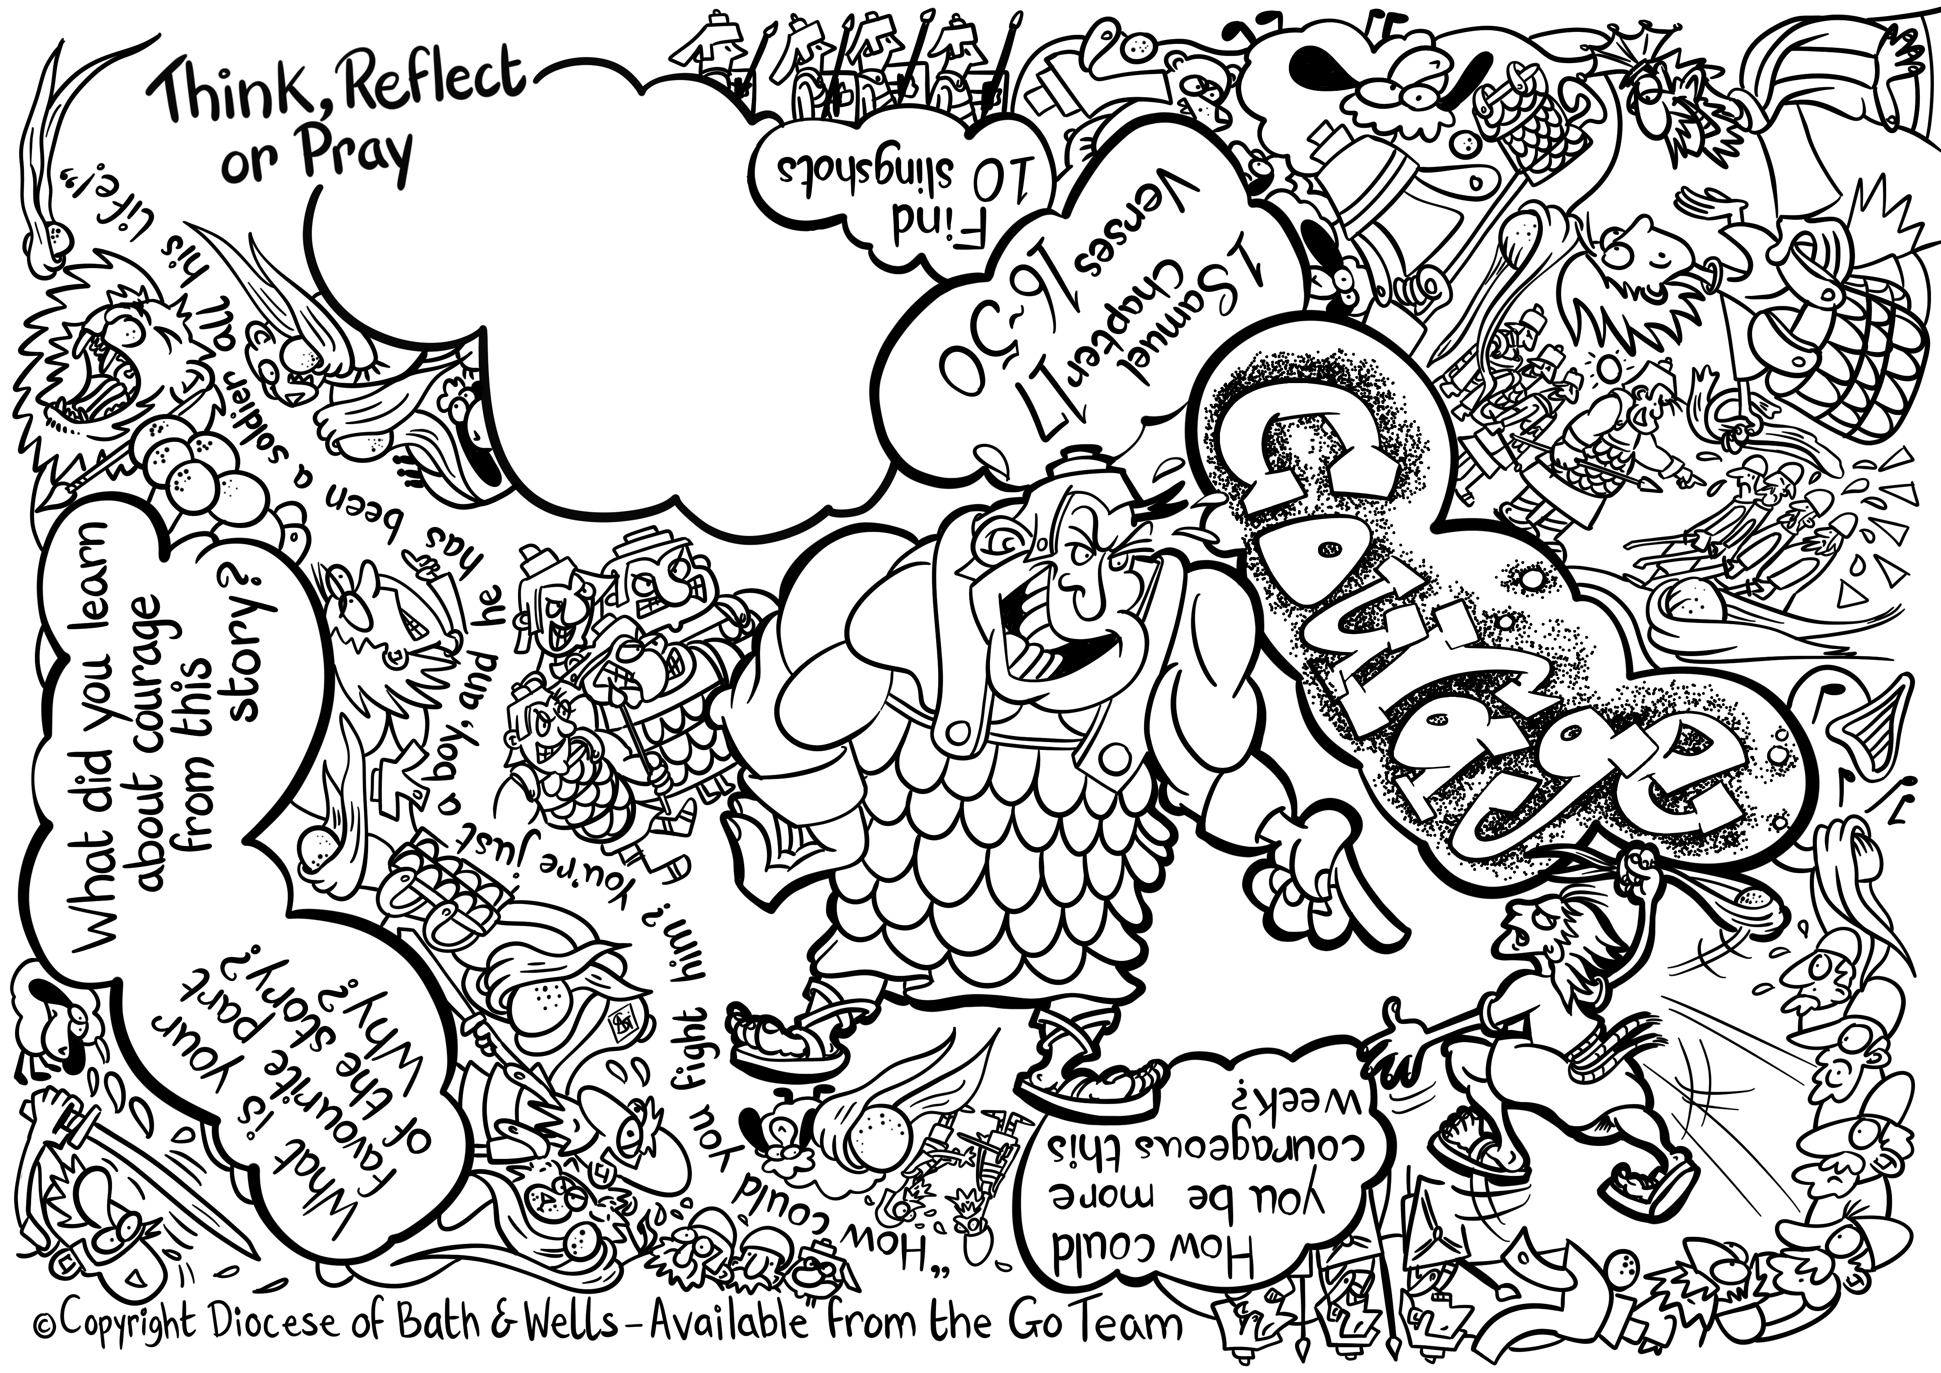
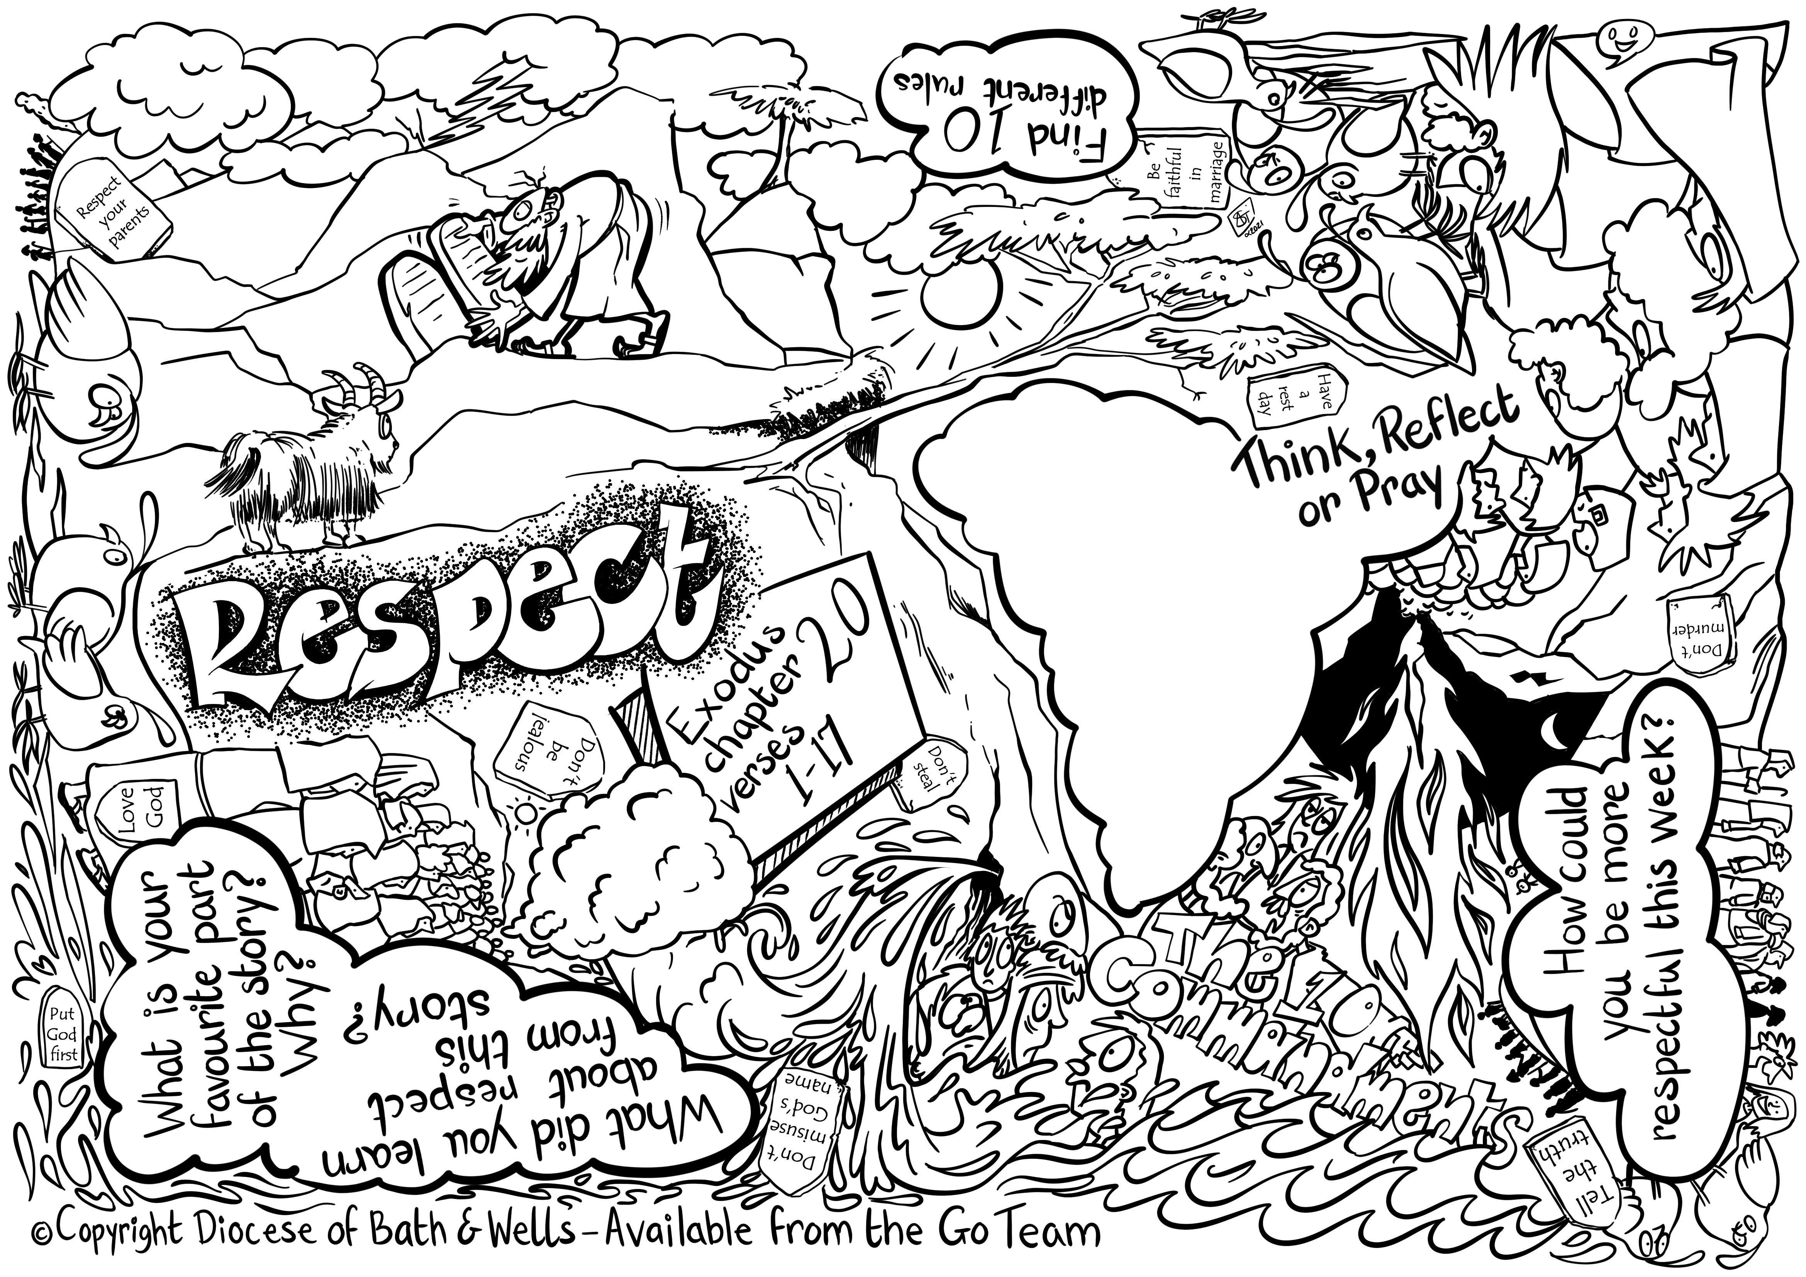
Go Team Update – Bible Chat Mats

Slide 6
The Archbishop of York Young Leader’s Awards
KS1 – KS4+
Well-being
Hope-builder
Character Education
Courageous Advocacy

Slide 7
School Effectiveness updates
• CofE FfEL – Foundation for Educational Leadership
www.cefel.org.uk
• CPD
School questionnaire
www.bathandwells.org.uk/supporting-children/education-training-events
https://www.bathandwells.org.uk/supporting-children/our-approach/school-support-questionnaire/
• Wellbeing resources
Mind Ed and the Anna Freud Centres updated resources – ‘Wellbeing for Education Return’
www.minded.org.uk
• School Inspections
• Diocesan Prayer Calendar
www.bathandwells.org.uk/ministryformission/discipleship/
calendar-prayer/

Slide 8
Spiritual Leadership
‘Spiritual leadership is the privilege of embedding a thread and opportunities throughout the context of the school community and the curriculum that touch the spirit. ‘
• Who are the spiritual leaders in our school community?
• How do they foster spirituality?
• What supports and equips your spiritual leaders?

Slide 9
Spiritual Development
• SIAMS inspection area for development?
• Strand 2 of the new SIAMS schedule
• Spiritual Development Policy
• CPD – Spirituality in Schools Wed 5th May 4-5.30pm
• Spirituality Overview Training Video

Slide 10
SIAMS – next steps
Most likely restart September 2021
The ‘catch up’ – probably chronologically
Same schedule (2019) one day, one week’s notice – some temporary modifications
National admin system – notification - timing of inspections
Our support – best wishes and prayer, advice, training, staff meetings, SIAMS conversations, mid-term reviews

Slide 11
SIAMS – how can I be ready?
Your Covid story: How have you lived out your school’s vision and values?
Mapping your provision against the seven strands of the inspection (SEF)
Looking at impact – how have children and adults flourished in the past year?
Keeping the evidence - letters, examples of children’s work, photos, parental feedback

Slide 12
Breakout rooms
How have you kept SIAMS alive over the past year?
What sort of evidence can you keep?
Plans to develop/embed your school’s vision and values now all children are back in school?

Slide 13
School Organisation Updates
Multi School Groupings
Gavin Williamson’s steer re academisation
Cross Diocese working
SRMA Diocesan Deployment feedback
New school site for King Ina

Slide 14
Environmental Policy
Diocesan Policy, Creation Care, approved by Synod
Education department included in working group – key stakeholder
Action plan also agreed by Synod
Education Department drawing up its action plan by team (SE,SO.GO) within the overall action plan

Slide 15
Bridging the Diversity Gap 17th May 6-7.30pm via Zoom
Replacing the next HT/Chairs Briefing in May
Major Cross Diocese event
Led by Sharon Warmington CEO National Black Governors Network
Why is diversity good for school communities?
Other diversity initiatives we are involved with

Slide 16
Foundation Governor Recruitment

Slide 17
Foundation Governor Recruitment
Current position
• Vacancies – 15%
• VA’s – 13%
• VC’s – 6%
• Academies – 22%

Slide 18
What have we been doing?

Slide 19
What have you been doing?
• What works?
• Hints & Tips
• Support

Slide 20
Thank you
You will have received an email with a link to the following:
Feedback form – we would really like to hear what you think of our training
The power-point slides used in this session
Any resources referred to in this session
Further CPD opportunities
Please visit our website for more information www.bathandwells.org.uk/supporting-children/

