Slide 1
‘Help, I’ve been given RE!
Pauline Dodds
October 2020

Slide 2
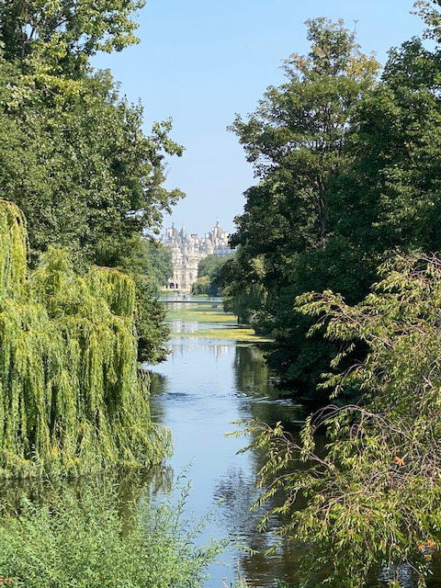
Reflection – Isaiah 43
Lord God, you are always with me.
You are with me by day and by night.
You are with me when I am happy and when I am sad.
You are with me when I am peaceful and when I am anxious.
Help me to remember and be thankful.
Amen

Slide 3
Content of the session
Why we teach RE – its aims and purposes
The role of the subject leader
What we teach – our syllabus and long term planning
How we teach – some creative ideas and resources
The impact of RE – assessment and evidence
Who will be checking – SIAMS and Ofsted

Slide 4
We teach RE because……
2) It encourages children to respect those with different faiths and worldviews
1) It is a legal obligation
3) It develops religious literacy
4) It is about awe and wonder
5) It helps overcome stereotypes and prejudice
6) It links with other areas of the curriculum
7) It gives an opportunity for prayer and worship
8) It is about things that happened in the past
9) It encourages children to become believers
10) It develops learning skills of questioning, exploring and investigation
11) It is an effective means of developing pupils’ spiritual, moral, social and cultural awareness
12) It explores the big questions of life (and death)

Slide 5
The role of the subject leader
Keeping an evidence file
Leading and supporting colleagues
Monitoring and reporting
Building contacts for visits and visitors
CPD, subject knowledge, national developments
Budget and resources
Local collaboration and support
Being an advocate for RE
SIAMS and Ofsted

Slide 6
Knowing the law and church school expectations
RE for all registered pupils (1944)
Right to withdraw
Church of England ‘RE Statement of Entitlement’
provision, profile and priority
challenging, accurate and diverse curriculum
aims and objectives
curriculum balance and time (RE time 5-10%, 50% Christianity)
developing staff expertise and knowledge
local and national support

Slide 7
What we teach – the syllabus and long-term planning
Locally Agreed Syllabus (SACRE) ‘Awareness, Mystery, Value’ – ‘AMV Somerset 2019’
Voluntary Aided church schools and academies
Long-term planning (exemplar units – ‘Understanding Christianity’ – Discovery RE)

Slide 8
Discussion
Am I clear about the RE syllabus my school is using?
What do I know about my school’s long-term RE planning?
What do I need to find out?

Slide 9
How we teach – what we expect
Dedicated RE time
Knowledge organisers - knowledge-rich, sequential curriculum design
Clear planning with progression and assessment opportunities
Engaging learning activities – artefacts, art, drama, quizzes, the ‘Big Questions’, visits and visitors etc.
Effective questioning - religious literacy - subject knowledge
Evidence of learning – RE books - portfolios

Slide 10
Discussion
What do I know about the RE teaching and learning in the classrooms?
What do I need to find out?

Slide 11
Understanding Christianity
Aims and purposes:
For pupils to leave school with a coherent understanding of Christian belief and practice
To give pupils from Reception to Year 9 opportunity to explore key theological concepts within Christianity
To support teachers in developing their own knowledge and understanding of Christianity as a global world faith and to teach with confidence

Slide 12
God
Creation
Fall
People of God
Incarnation
Gospel
Salvation
Kingdom of God

Slide 13
People of God
Prophecy
Wisdom
Kingdom of God
God
Creation Fall
Incarnation
Gospel
Salvation
Creation/
Fall
People of God
Kingdom of God
God
Incarnation
Gospel
Salvation
People of God
Gospel
Kingdom of God
Creation/Fall
Incarnation
Salvation
God
Creation
Incarnation
Gospel
Salvation
Creation
Incarnation
Salvation

Slide 14
Notes:
Teaching & Learning APPROACH
The teaching and learning approach is fundamental to the Understanding Christianity resource. Teachers need to select from activities in each aspect to give a balance of learning activities

Slide 15
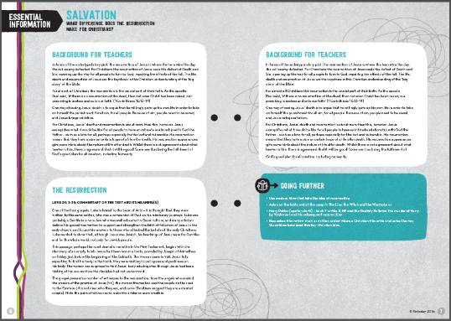
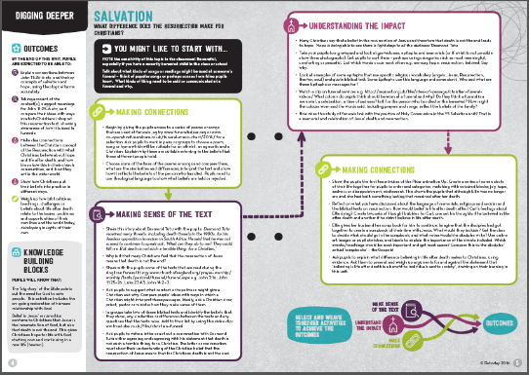
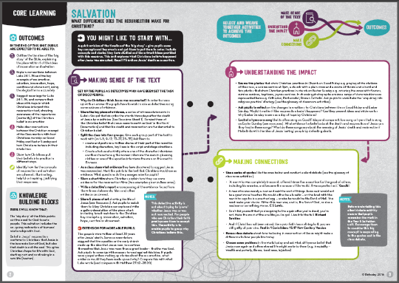
Essential information
Background for teachers
Links
Resources
Digging deeper
Core learning
Outcomes
Resource sheets
Building blocks
Teaching and learning suggestions
You might like to start with…
© RE Today 2016
Notes:
29 units of work provide rich resources for teachers – supporting their subject knowledge as well as offering a wide range of ideas and resources to teach the concepts in a variety of settings.
‘Essential information’ designed to give teachers some confidence in handling the content. To look at first!
‘You might like to start with…’ starter activities, bridge to pupils’ experience, imaginative ways in.
Etc.
Show example unit: Lower key stage 2 Incarnation/God – find in your files
Start with essential information or teachers > Core Learning > Digging Deeper (also mention downloadable resources)

Slide 16
Discussion
Is your school using Understanding Christianity?
Do the teachers feel confident using it?
How is it impacting on the children?
If you’re not yet using UC, what resource do you use to teach Christian belief and practice?

Slide 17
Resources
NATRE www.natre.org.uk/about-natre/free-resources-for-you-and-your-pupils/ (home learning)
BBC Bitesize Religious Education (KS1)
BBC ‘My Life, My Religion’ You Tube (KS2)
REQuest www.request.org.uk (Christianity)
Let’s Celebrate – Short films and games on a range of religions from CBeebies. Suitable for early years https://www.bbc.co.uk/cbeebies/shows/lets-celebrate
Face book: Primary RE, RE Subject Leaders (Primary) Save RE
Knowledge organisers - see Learn, Teach, Lead RE https://www.ltlre.org/resources/knowledge-organisers

Slide 18
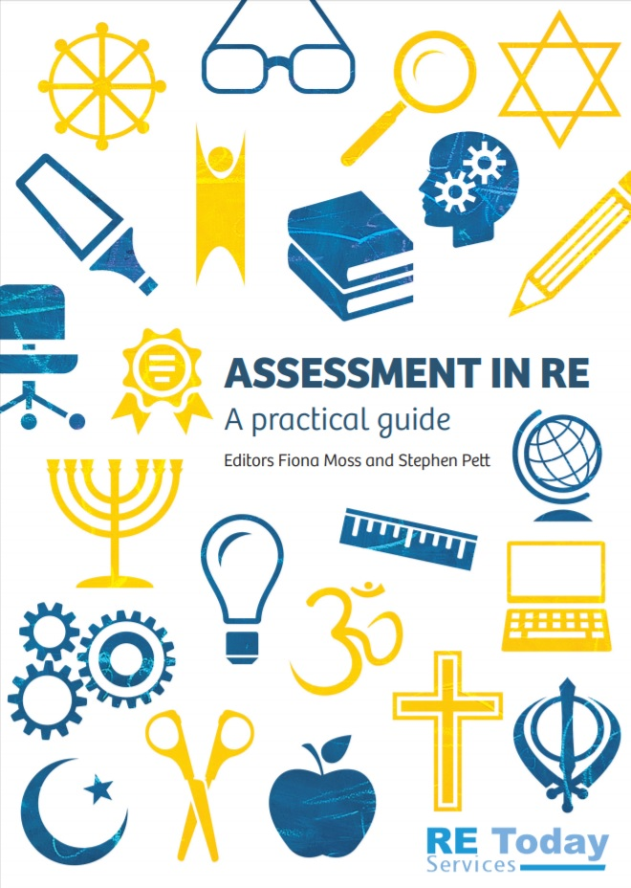
The impact of RE – assessment and evidence
Agreed syllabus assessment guidance
Understanding Christianity – the ‘Salisbury’ grids
RE Today publication
RE Quality Mark

Slide 19
Discussion
How often do you ask teachers to assess their children’s progress?
How do you ask them to record the results of the assessments?
How else might teachers demonstrate evidence of their children’s learning/progress?

Slide 20
Who will be checking? Ofsted and SIAMS
Ofsted:
Comments on the quality of provision of RE in a VC/community school, and compliance with the law
Broad and balanced curriculum – RE ‘Deep dives’
Subject leadership a new focus
SIAMS Strand 7:
‘How effective is the school in ensuring pupils flourish through the provision of high quality religious education, reflecting the Cof E Statement of Entitlement?’
‘How effective is the school in ensuring that religious education expresses the school’s Christian vision?’
‘How effective is RE teaching and learning in the school?’ (VA)

Slide 21
Discussion
Final opportunity for questions and comments on the chat box

Slide 22
Final reflections
• ‘Learn, Teach, Lead’ local RE hubs
• Bath & Wells website – RE page
• Please get in touch:
pauline.dodds@bathwells.anglican.org

