Slide 1

SIAMS
Statutory Inspection of Anglican and Methodist Schools
Pauline Dodds
January 2021

Slide 2
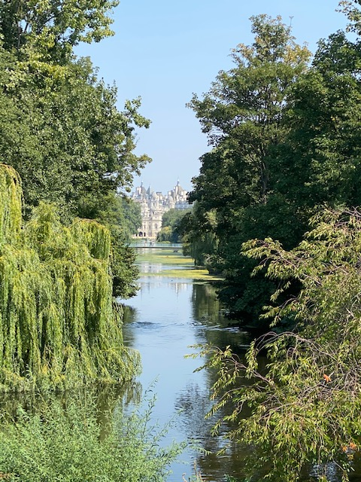
Reflection – Isaiah 43
Lord God, you are always with me.
You are with me by day and by night.
You are with me when I am happy and when I am sad.
You are with me when I am peaceful and when I am anxious.
Help me to remember and appreciate the small things, the acts of human kindness and be thankful.
Amen

Slide 3

Aims
To offer an overview of the 2018 SIAMS schedule
To understand the importance of vision with a Christian underpinning
To look at how a school is graded
To explore how to be ready: self-evaluation and ‘telling your Covid story’

Slide 4
The current situation
Postponed inspections in Bath & Wells
Spring term 2020: 3
Summer term 2020: 26
Autumn term 2020: 18
Spring term 2021: 13
Small modifications to schedule (time-limited)
Inspector re-training (online)

Slide 5
Time for discussion
Introductions
Discuss any previous experience of SIAMS or SIAS
Ofsted?

Slide 6

SIAMS - key document
SIAMS Evaluation Schedule for Schools and Inspectors

Slide 7
Why the changes in 2018?
More consistency
A new educational landscape
‘It is a matter of affirming what is of worth in the past and the present, rejecting courageously things that we judge unwise, and working to transform those that are valuable but need improvement’
The Church of England Vision for Education ‘Deeply Christian, Serving the Common Good’

Slide 8

2016 C of E Vision for Education
‘Deeply Christian, Serving the Common Good’
Educating for Wisdom, Knowledge and Skills
Educating for Hope and Aspiration
Educating for Community and Living Well Together
Educating for Dignity and Respect

Slide 9


Slide 10
The importance of your school’s vision
Deeply Christian sets the criteria
Diocesan vision sets the local context
The school’s vision must be unique to the community
New schedule gives high profile to the school’s Christian vision
Serving the whole community
Inspection is in the context of the school’s own vision

Slide 11
Important questions for school leaders and governors
Who are we?
Why are we here?
How then do we live?
Imagine you are explaining this
to parents and carers

Slide 12
Questions for discussion
What is your school’s vision?
When was it last revisited?
How does it reflect your school’s Christian foundation?
Notes:
.

Slide 13

SIAMS – the overarching question
How effective is the school’s distinctive Christian vision, established and promoted by leadership at all levels, in enabling pupils and adults to flourish?

Slide 14
Strand 2
Wisdom, Knowledge, Skills
Strand 3
Hope, Aspiration, Courageous advocacy
Strand 7
Religious Education
Strand 1
Vision and Leadership
Strand 6
Collective Worship
Strand 4
Community and Living Well Together
Strand 5
Dignity and Respect

Slide 15
What is where in the Evaluation Schedule?
Each strand outlines (p2-16):
What the inspector must explore
What the school should evaluate
Grade descriptors for a good Church school
Examples of what excellence might look like
Ineffective as a Church school (p17)
Reporting (p18)
Glossary (p19)

Slide 16
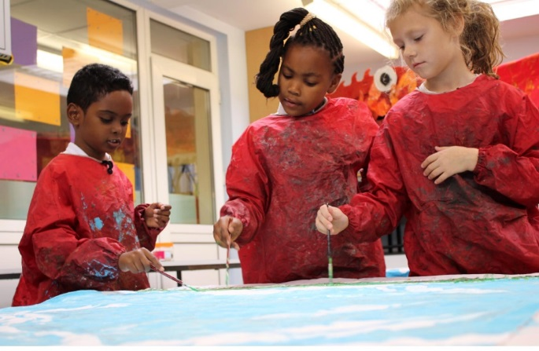
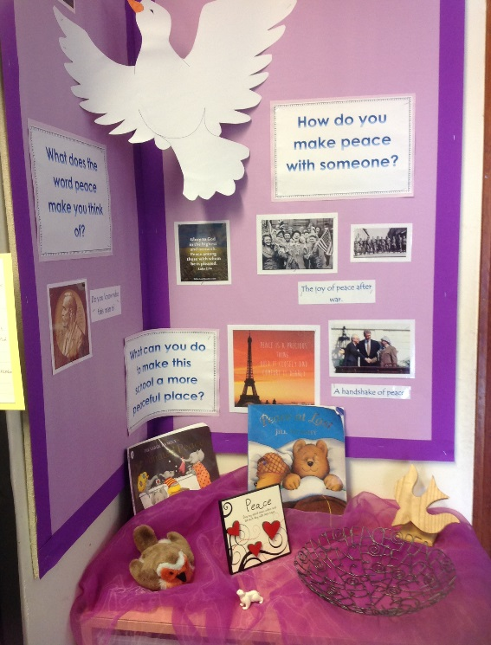
Strand 2: Wisdom, Knowledge and
Skills p 5-6
Standards
Curriculum decisions
Supporting vulnerable pupils
Spirituality: approach

Slide 17

Strand 3: Hope, Aspiration and Courageous Advocacy p7-8
Character Education: values to over come barriers to learning etc (Aspiration)
Courageous advocacy: challenging disadvantage, deprivation and exploitation (Hope)
Charity work
Global Neighbours (overseas links)

Slide 18

Strand 4: Community and living well together p 9-10
Forgiveness and reconciliation
Behaviour, exclusion and attendance policies
Mental health

Slide 19
Strand 5: Dignity and respect p 11-12
Policy and practice
School as a safe environment
Celebrating difference and diversity
Anti bullying (‘Valuing all God’s Children’)
RSE
(‘Goodness and Mercy’)
Promoting self-esteem

Slide 20
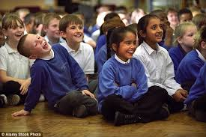
Strand 6: The impact of collective worship p13-14
Invitational
Inclusive
Inspiring
Collective Worship that expresses the vision of the school

Slide 21

Strand 7: The effectiveness of RE p 15-16
Non-confessional and an academic subject
Christianity as a living world faith
Knowledge and understanding of major world religions
RE ‘Statement of Entitlement’

Slide 22
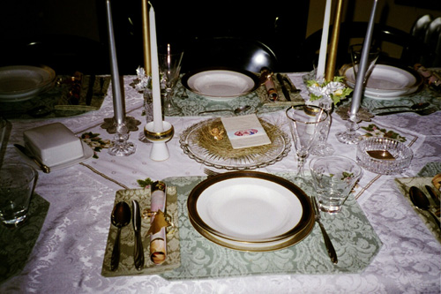
RE in VA (or former VA) schools
RE is an academic subject in all church schools
There should be self-evaluation of RE in all schools
Separate paragraph on RE teaching and learning in VA schools

Slide 23
Group discussion
Which strand/s might be a particular strength in your school?
Which strand/s might you particularly want to develop?

Slide 24


A new way of thinking about grades
The inspector will explore the single inspection question via seven strands
to inform one inspection grade
In addition, in all schools there will be a grade for collective worship
In VA (or former VA) schools there will be an additional grade for RE

Slide 25
A new way of thinking about grades
Is the school’s case for Excellent convincing?
Starting point for inspectors
Is this a Good church school?
The school is not good and Requires Improvement
….are the weaknesses significant enough for a grade of Ineffective?

Slide 26
Excellence
Leaders use bold ethical arguments for inclusion
Innovative practice through partnerships
a successful record of developing future Church school leaders
In an excellent school…
Pupils are articulate advocates of change, against injustice and inequality
Vision shapes the strategic and operational direction
School is recognised as a centre of excellence

Slide 27
Reflections and chat
Reflect on the SIAMS schedule and process

Slide 28
How to be ready - ongoing self evaluation
Vision
Provision
Impact
What is your school’s vision?
What do you do as a result of your vision?
What is the impact?

Slide 29
The SIAMS SEF
‘Vision, Provision, Impact’
School context
School vision
Headline data
Policy checker
Seven strands: Actions taken and impact
Making your case for excellence

Slide 30
Ongoing self-evaluation some hints
Focus on actions and impact
Other creative ways of presenting
SEF summary
Gathering and keeping evidence
Governor monitoring
Website
Keeping SIAMS ‘on the boil’

Slide 31
In these times….
How has your school’s vision sustained your school community in these last months?
Record any actions in response to Covid against the seven strands (photos, letters, children’s work etc.)
‘How do we sing a new song in a strange land?’
Psalm 137

Slide 32
Final reflections and questions for the chat box
Notes:
.

Slide 33

Further information
Bath & Wells website (SIAMS page)
Church of England website
We are here to help - please contact us at any time and thanks for joining us
Pauline Dodds
pauline.dodds@bathwells.anglican.org

