Slide 1
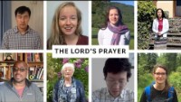
Notes:
The Lord's Prayer in Different Languages | Pentecost 2020
https://www.youtube.com/watch?v=aDcwX_3DIJw
Cof E Devon

Slide 2
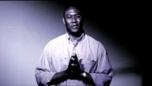
Notes:
Full Lord’s Prayer in each language – Ginghamsburg Church
https://www.youtube.com/watch?v=gbsPF4xvDps

Slide 3
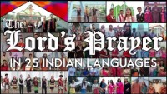
Notes:
The Lord’s Prayer in 25 Indian languages
https://www.youtube.com/watch?v=0LaefdPG0KY

Slide 4

Notes:
The Lord’s Prayer, instrumental with Piano & Violin
Ouachita Hills College
https://www.youtube.com/watch?v=BsThnS6LuOk

Slide 5

Notes:
Saddleback Kids
https://www.youtube.com/watch?v=ijPuAtrwHYM

Slide 6
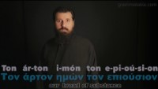
Notes:
The Lord’s Prayer in Greek
https://www.youtube.com/watch?v=61KFmiFrp78

Slide 7
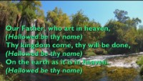
Notes:
A Caribbean Lord’s Prayer – arrangement by Michael Lehr
https://www.youtube.com/watch?v=6nh_H-HYKu8

Slide 8

Notes:
The Lord’s Prayer – Summit Kids
https://www.youtube.com/watch?v=uax7wNcjqtQ

Slide 9

Notes:
The Lord’s Prayer Lyric song - Hillsongs

Slide 10

Notes:
Avinu Shebashamayim – The Lord’s Prayer in Hebrew – Gabriel Souza
https://www.youtube.com/watch?v=H3gQrUGKWLA

Slide 11
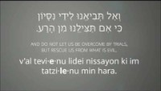
Notes:
Avinu Shebashamayim: The Lord's Prayer in Hebrew
https://www.youtube.com/watch?v=EpOvrGXgEB8

Slide 12

Notes:
Abun d'beschmayo, The Lord's Prayer in Aramaic
https://www.youtube.com/watch?v=PC9nrU90b1U

